Slide 1

Final Presentation
By: Christopher McDaniel
For: MATH 3379
Date: 20 Nov. 2018

Slide 2
Introduction and Background
White-tail deer are probably one of the most commonly hunted big game animals in Texas and other, similar, states. The males (bucks) of the species are probably some of the most sought after in terms of trophies, with females for meat, although some hunters will look at a buck for meat instead of as a trophy. In the data set covered it compares the percentage of bucks harvested across three years. In the article titled “Effects of Deer Density and Land Use on Mass of White-Tailed Deer”, the authors elaborate on the density of deer and how it can affect their ecosystem. In another article titled “Influence of Habitat Features and Hunter Behavior on White-Tailed Deer Harvest”, the authors are talking about how environmental conditions can effect the hunter’s harvest of the white-tailed deer for the year. In the final article (“Effect of Hunter Selectivity on Harvest Rates of Radio-Collared White-Tailed Deer in Pennsylvania”) the authors talk about how radio transmitters did not have the effect they expected on which deer the hunter’s where expected to harvest.

Slide 3

Hypothesis
If the buck is older, then most hunters will harvest them instead of younger bucks.

Slide 4
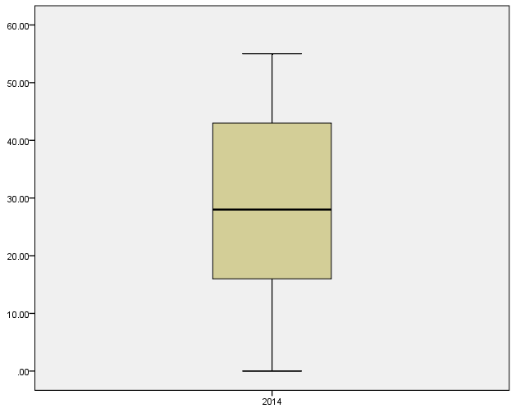
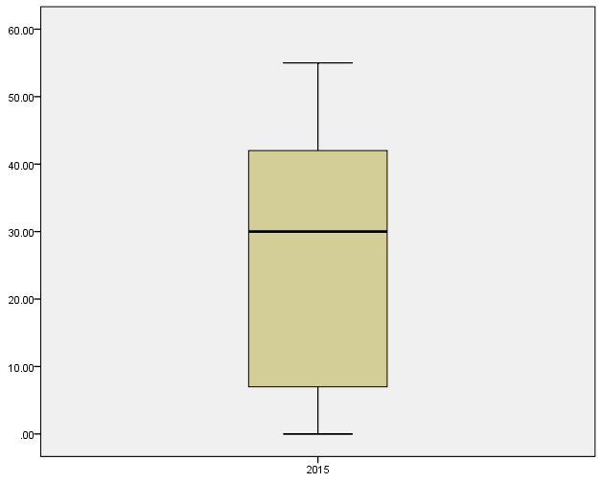
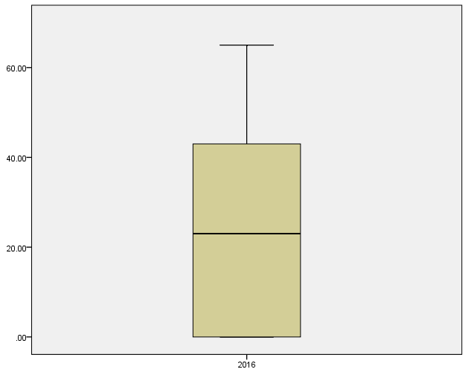
Boxplot of 1.5 Year Old Bucks

Slide 5
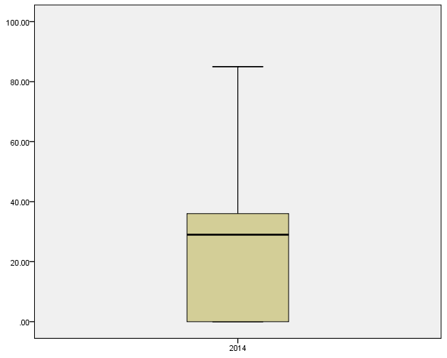
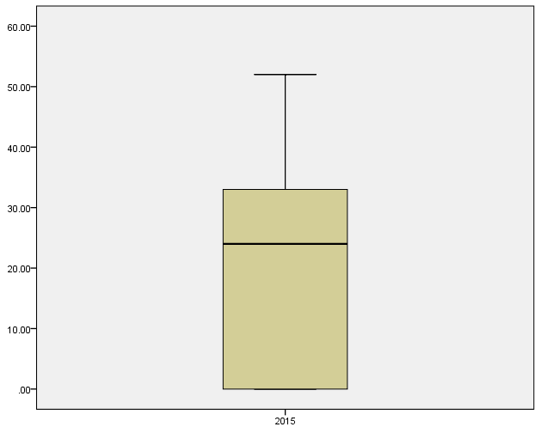
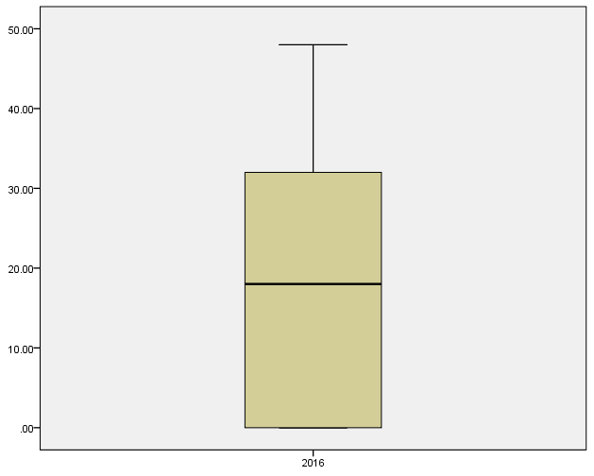
Boxplot of 2.5 Year Old Bucks

Slide 6
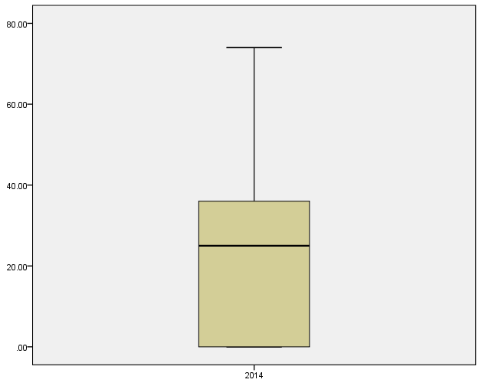

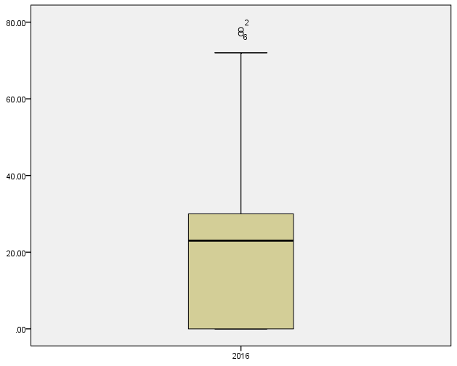
Boxplot of 3.5 Year Old Bucks

Slide 7
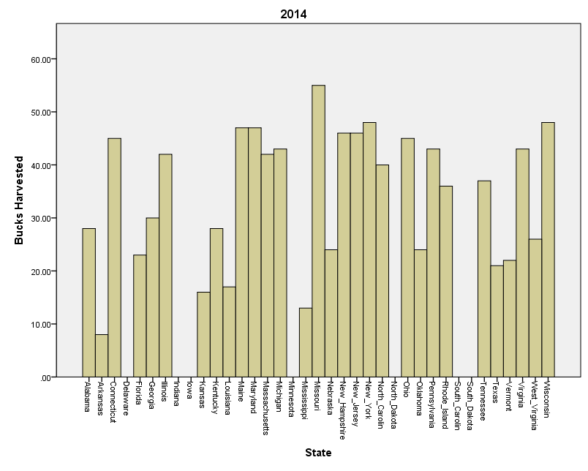
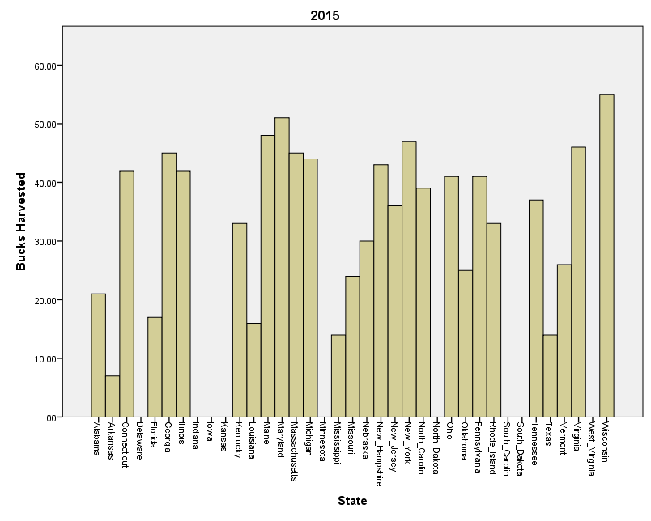
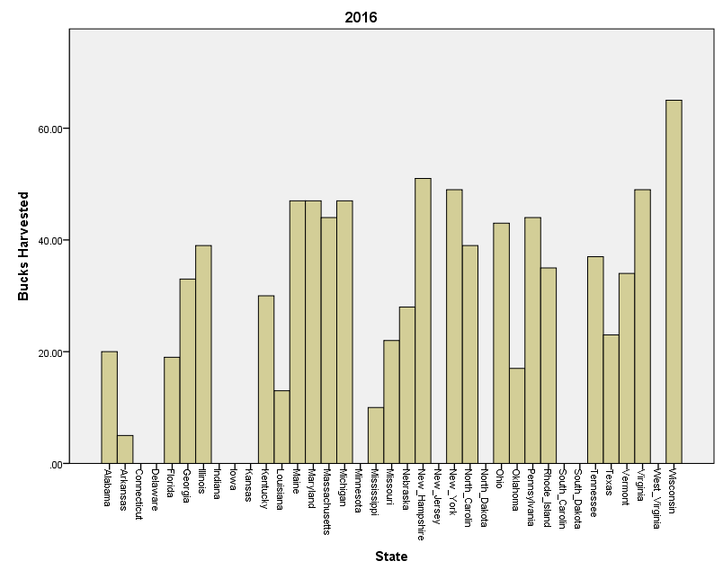
Histogram of 1.5 Year Old Bucks

Slide 8
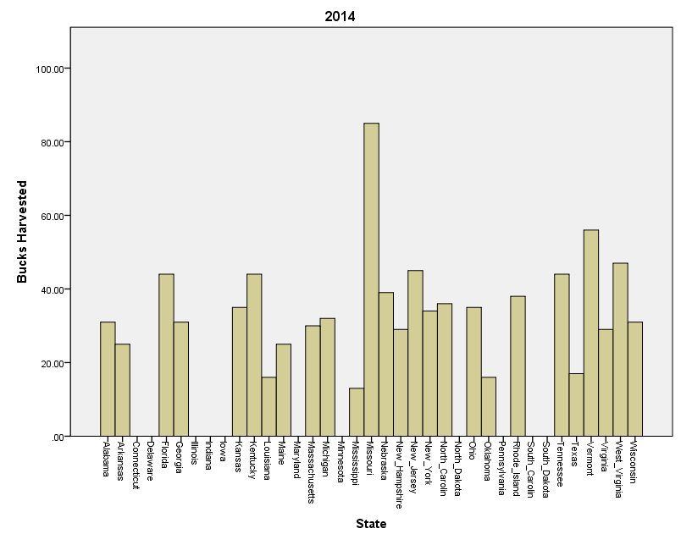
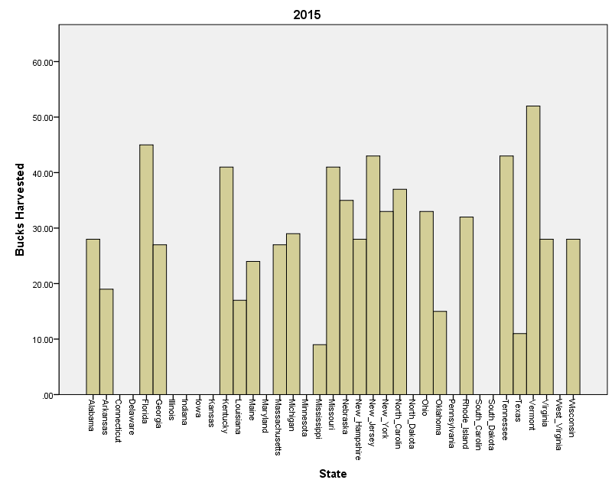
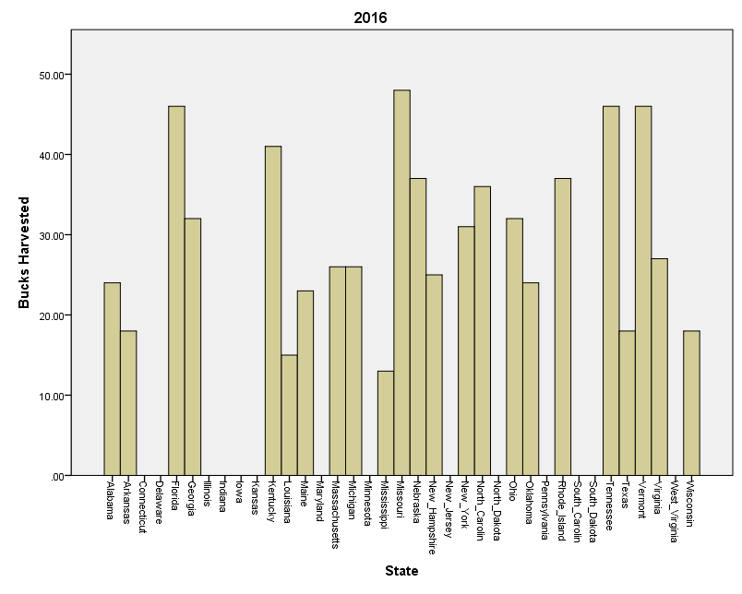
Histogram of 2.5 Year Old Bucks

Slide 9
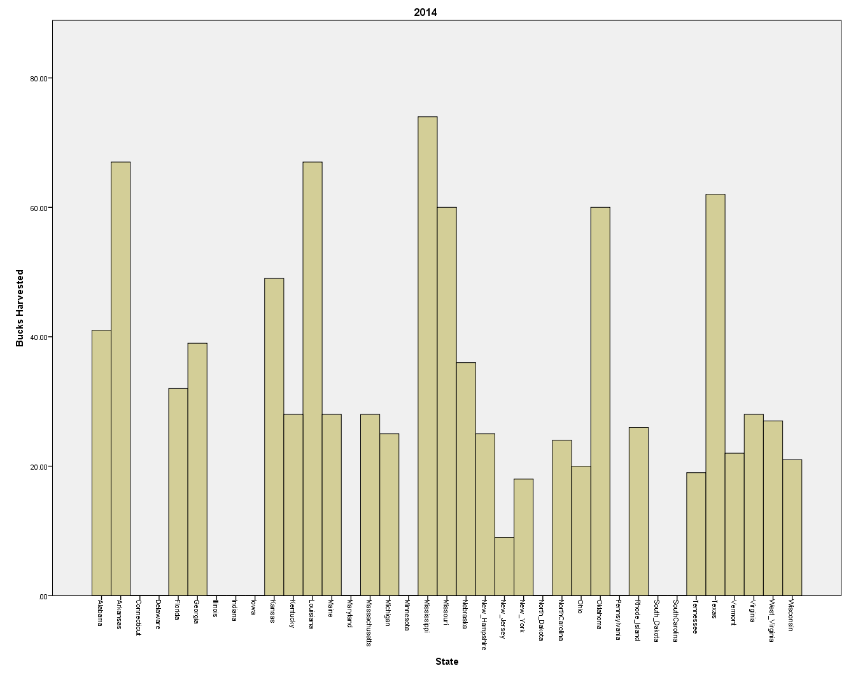
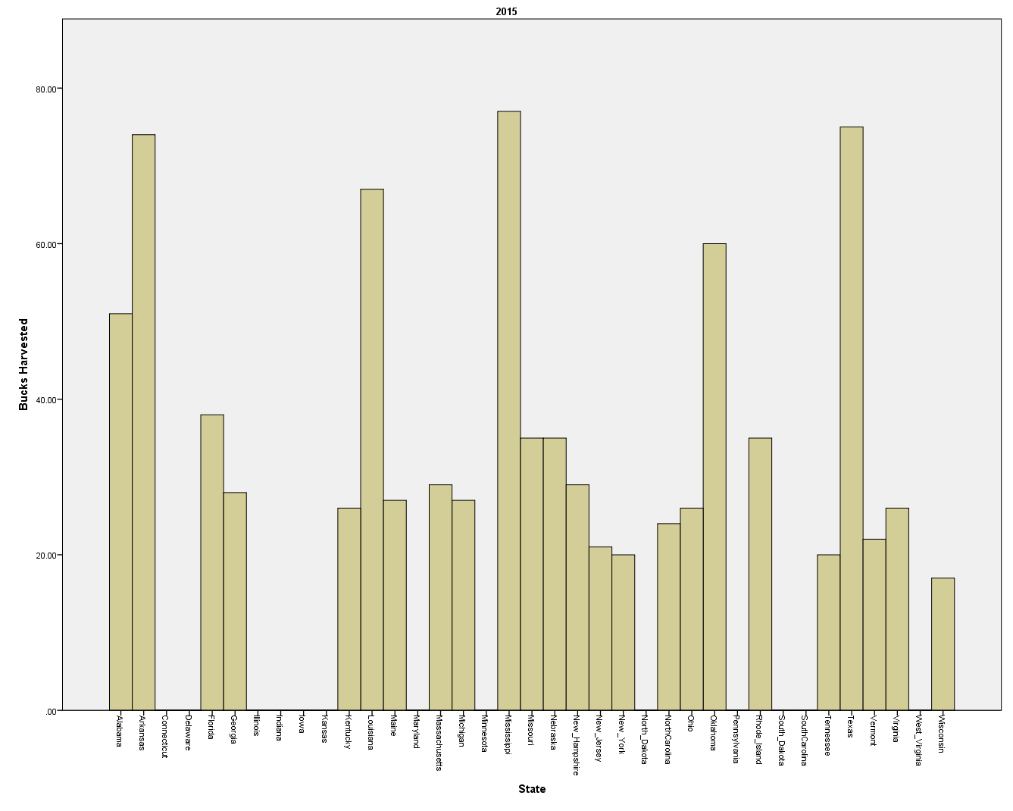
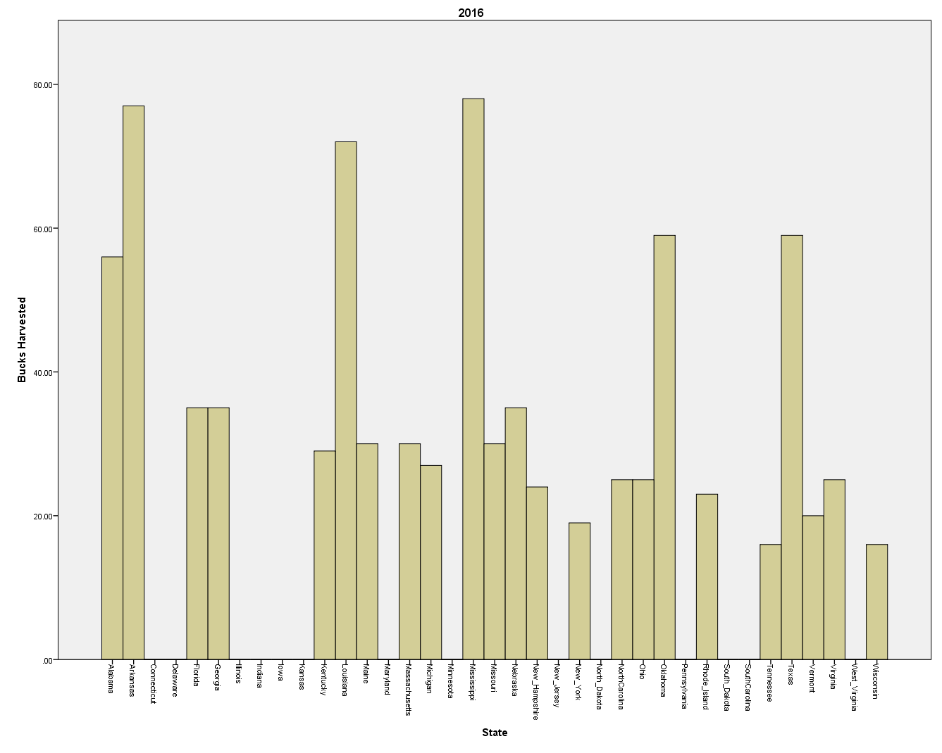
Histogram of 3.5 Year Old Bucks

Slide 10
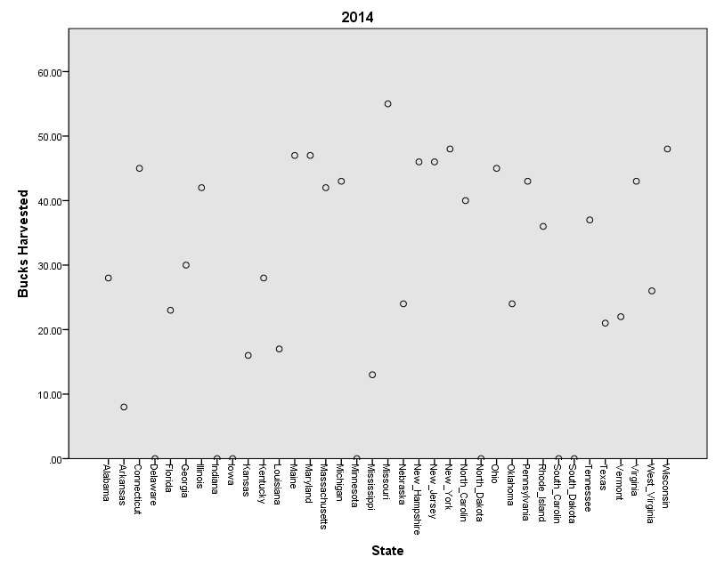
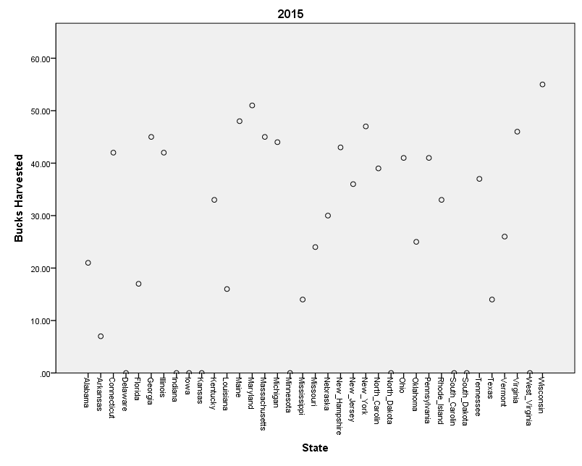

Scatterplot of 1.5 Year Old Bucks

Slide 11

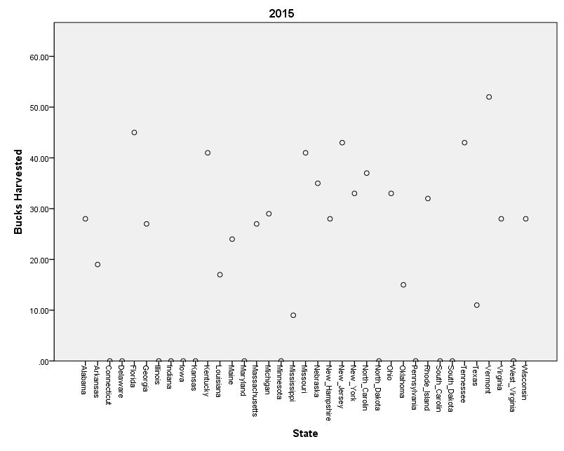

Scatterplot of 2.5 Year Old Bucks

Slide 12



Scatterplot of 3.5 Year Old Bucks

Slide 13
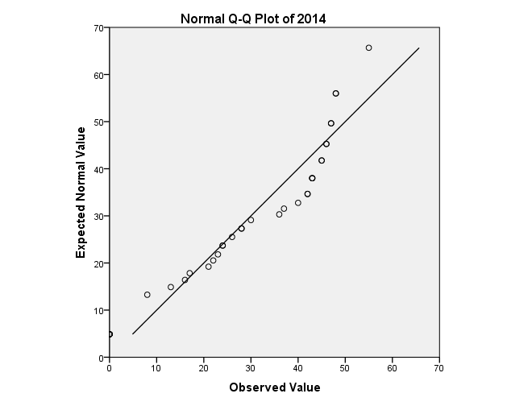

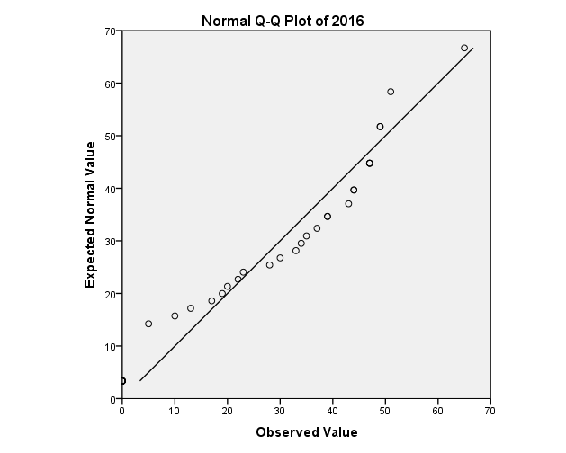
Normality Plot of 1.5 Year Old Bucks

Slide 14
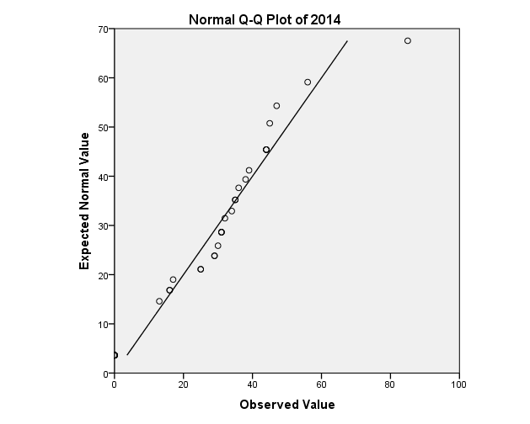

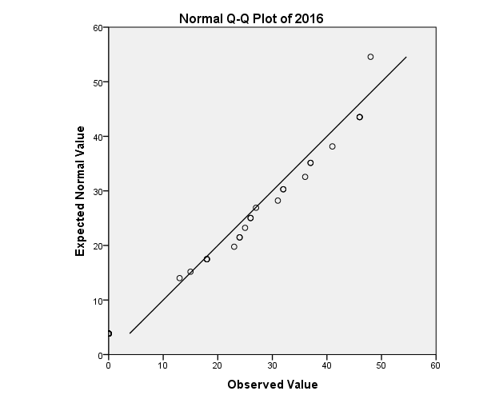
Normality Plot of 2.5 Year Old Bucks

Slide 15
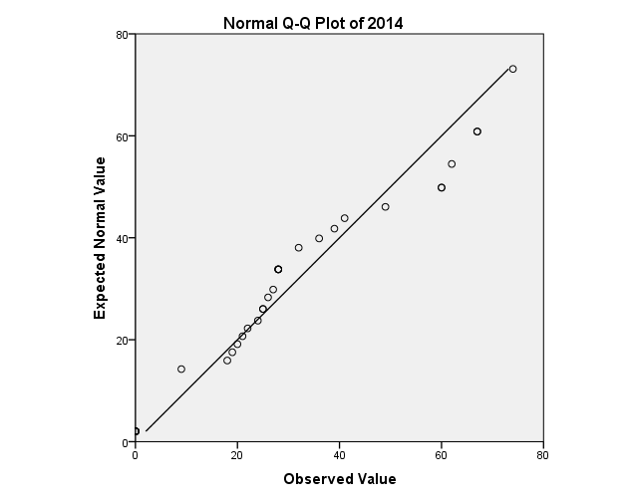
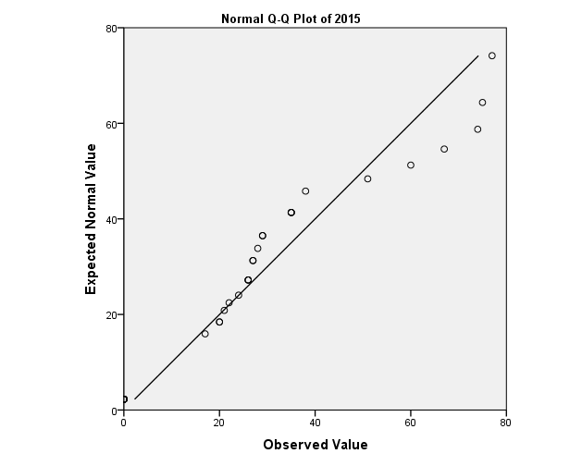

Normality Plot of 3.5 Year Old Bucks

Slide 16
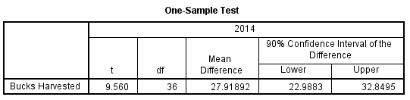


Calculations for Test of Hypothesis for 1.5 Year Old Bucks

Slide 17

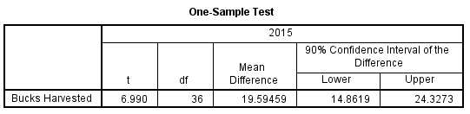

Calculations for Test of Hypothesis and Confidence Interval for 2.5 Year Old Bucks

Slide 18



Calculations for Test of Hypothesis for 3.5 Year Old Bucks

Slide 19
Bibliography
BUDERMAN, F., DIEFENBACH, D., ROSENBERRY, C., WALLINGFORD, B., & LONG, E. (2014). Effect of Hunter Selectivity on Harvest Rates of Radio-Collared White-Tailed Deer in Pennsylvania. The Journal of Wildlife Management, 78(8), 1456-1465. Retrieved from http://www.jstor.org.ezproxy.shsu.edu/stable/43188288
LEBEL, F., DUSSAULT, C., MASSÉ, A., & CÔTÉ, S. (2012). Influence of Habitat Features and Hunter Behavior on White-Tailed Deer Harvest. The Journal of Wildlife Management, 76(7), 1431-1440. Retrieved from http://www.jstor.org.ezproxy.shsu.edu/stable/23251441
Trevor J. Hefley, Scott E. Hygnstrom, Jason M. Gilsdorf, Gregory M. Clements, Myndi J. Clements, Andrew J. Tyre, David M. Baasch, and Kurt C. VerCauteren (2013) Effects of Deer Density and Land Use on Mass of White-Tailed Deer. Journal of Fish and Wildlife Management: June 2013, Vol. 4, No. 1, pp. 20-32.

Slide 20
Conclusion and Interpretation
In conclusion, there is sufficient evidence to fail to reject the null hypothesis because the test of hypothesis is less than the critical value, so the average hunter will harvest an older buck rather than harvest a younger one.
I can be 90% confident that the true population mean will be between 16.264 and 29.412.

